Slide 1
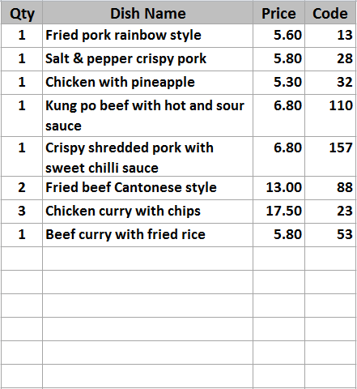
Delivery
2
Shop
Mixed hot platter
Mixed hot platter
Mixed hot platter
Mixed hot platter
Duck spring rolls
Duck spring rolls
Duck spring rolls
Duck spring rolls
Beef ginger and
spring onion
Beef ginger and
spring onion
Beef ginger and
spring onion
Beef ginger and
spring onion
Chicken yellow bean
cashew nuts
Chicken yellow bean
cashew nuts
Chicken yellow bean
cashew nuts
Chicken yellow bean
cashew nuts
MENU 1
Roast
Pork
Roast
Pork
Roast
Pork
Roast
Pork
Roast
Pork
SEARCH
MEAL
Szechuan
Szechuan
Szechuan
Szechuan
Szechuan
LANGUAGE
BBQ
Sauce
BBQ
Sauce
BBQ
Sauce
BBQ
Sauce
BBQ
Sauce
CHANGE
ORDER TYPE
Tomato
Tomato
Tomato
Tomato
Tomato
11
£67.95
18:48:30
86
Remove
Item
KEYPAD
Foo
Yung
Foo
Yung
Foo
Yung
Foo
Yung
Foo
Yung
+
-
Cust
Info
CID
+ / -
PAY
CANCEL
ORDER
Tray Meal
Tray Meal
Tray Meal
Tray Meal
Tray Meal
Desktop
Pending
Orders
Tray Meal
Tray Meal
Tray Meal
Tray Meal
Tray Meal

Slide 2
Control Panel
System Setting
System
Configuration
User
Maintenance
Data Manager
Compact
Database
Computer
Address
Shift Code
Takeaway & Quick Dining Setting
Takeaway
Configuration
Menu Category
Menu Item
Manage
Menu Set
Extra Menu
Edit
Order Control
Department
Code
Table Setup
Print Setup
Driver
Setup
Eat In Setting
Eat-In
Configuration
Menu Category
Menu Item
Manage
Menu Set
Extra Menu
Edit
Order Control
Department
Code
Table Setup
Printer
Order Entry
Print Setup
Reporting
Account
Summary
Reports
System
Control
Exit

Slide 3
Takeaway Configuration
General Setting
Delivery Settings
Post Code Settings
Payment Type and Surcharges
Auto Discount Settings
Payment Type
Surcharge Threshold
Surcharge Amount
Surcharge %
Delivery Discount %
10
Cash
0.00
0.00
Delivery Discount Threshold
20
Debit Card
10.00
1.00
5
Collection Discount %
9
Credit Card
0.00
1.00
0.00
Collection Discount Threshold
20
Cheque
0.00
Shop Discount %
8
0.00
Shop Discount Threshold
20
Others
Menu Display Font
Till Number
2
Menu Dish Button Font Size
9
Display Item Code Select
Menu Dish Code Font Bold
View Orders
Button View
Category Button Font Size
9
Category Button Font Bold
Free Food Items
Total Amount Threshold
20.00
Free Food Item Dish Code
18
23
78
103
Save
Exit

Slide 4
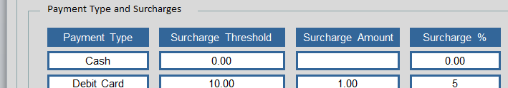

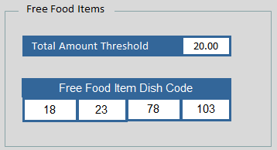
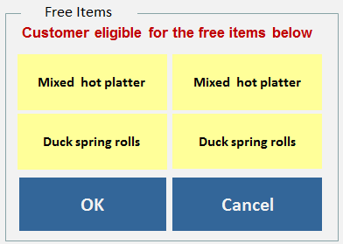

Takeaway Configuration
Defines payment method, maximum is 5. Threshold is to define when to apply surcharge in absolute amount or in %
Till Number
2
Till Number is the computer till number ID
Display Item Code Select
Display Item Code Select will show the dish code in front of the dish
View Orders
Button View
Define the default page to view if Pending Order is pressed
If the order amount is larger than say £20. Free food items are available to customers
When the order size is larger than a threshold, discount will be applied

Slide 5
Takeaway Configuration
General Setting
Delivery Settings
Post Code Settings
Delivery Distance Charge
Distance From
Distance From
Amount To Pay
0.00
3.00
1.00
3.01
5.00
2.00
5.01
6.00
3.00
1.00
Per Mile Thereafter
Delivery Surcharge
Order Threshold
15.00
Surcharge Amount
1.00
Charge Options
Delivery Charge Includes In Order
Ignore Delivery Surcharge When Distance Exceeds
3
Miles
Ignore Delivery Distance Charge If Surcharge Applies
Save
Exit

Slide 6
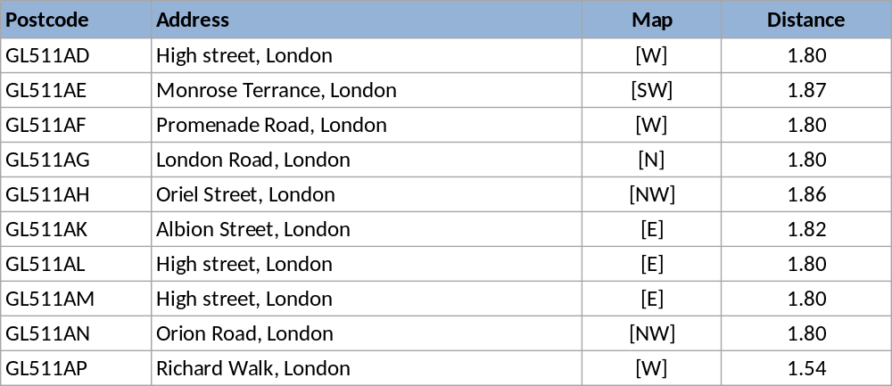
Takeaway Configuration
General Setting
Delivery Settings
Post Code Settings
Post Code
GL50 1DD
Map Ref
[N]
Distance
1.80
Address
High street, Cheltenham, GL50 1DD
Search by Postcode
Search
SN10 3DD
Your Location
Your STD
01380
Your Postcode
SN10 3EQ
Your X
333100
Your Y
188100
Add
New
Save
Refresh
Delete
Exit

Slide 7
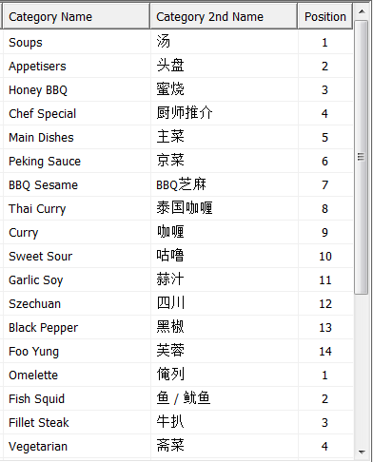
Menu Category
Menu Set
Chinese
Happy
Meal
3
4
Category
Name in English
Curry
Other Name
咖哩
Display Position
61
Department Code
Department Code
KIT
Add
New
Copy
Delete
Save
Exit

Slide 8
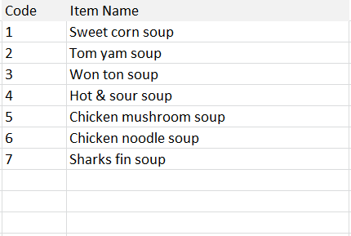
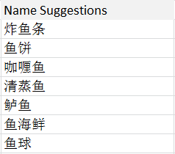

Menu Item
Dish Attributes
Second Choices
Third Choices
Taste Handling
Sub Menu
Menu Set
Button Colour
Chinese
Happy
Meal
3
4
Dish Code
98
Display Position
98
Supply Shift
All Day
Dish code search
Dish category search
Printer Name
By Dept
English Name
Dish Code
61
Search
Soup
Chicken mushroom
Printer Order
X
Other Name
蘑菇雞
Large Regular Small
Search Other Name
5.00
3.50
2.50
Dish Name
Fish
Search
Special Promo Prices
Copy
Large Regular Small
4.00
3.20
2.20
Menu Category
Unavailable
Discountable
Without VAT
Add
New
Copy
Delete
Save
Exit

Slide 9
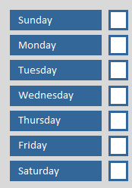
Menu Item – dish attributes
Print Order set to X for not printing this item on the customer bill
Default kitchen printer for this dish is By Dept, can be set to KIT, STA….
This dish belongs to three categories, Fried Rice, Chicken and Curry
When the order size is larger than a threshold, discount will be applied
Print Order set to X for not printing this item on the customer bill
Default kitchen printer for this dish is By Dept, can be set to KIT, STA….
This dish belongs to three categories, Fried Rice, Chicken and Curry
Copy is to used to copy current to create a new dish. Only Dish Code box will be clear, all other attributes will remain intact
Search Other Name – a look up dictionary. Type in Fish shows all possible words in Other language, copy it will go to the Other Name box

Slide 10
Menu Item
Dish Attributes
Second Choices
Third Choices
Taste Handling
Sub Menu
Menu Set
Chinese
Happy
Meal
3
4
Enable Choices
Copy Choices
English Name
Other Name
Add.
Price
Auto Append
Dish code search
Dish category search
Mushroom
蘑菇
1.50
Dish Code
61
Search
Soup
Chinese leaf
紹菜
1.50
Aubergine
茄子
1.50
Mooli
蘿蔔
1.50
Needle mushroom
金針菇
1.50
Kai Lan
芥蘭
1.50
Pak Choi
白菜
1.50
Add
New
Copy
Delete
Save
Exit

Slide 11
Menu Item
Dish Attributes
Second Choices
Third Choices
Taste Handling
Sub Menu
Menu Set
Chinese
Happy
Meal
3
4
Enable Choices
Copy Choices
English Name
Other Name
Add. Price
Auto Append
Dish code search
Dish category search
Fried Rice
炒飯
0.50
Dish Code
61
Search
Soup
Boiled Rice
白飯
0.00
Chips
薯條
0.00
Add
New
Copy
Delete
Save
Exit

Slide 12
Menu Item
Dish Attributes
Second Choices
Third Choices
Taste Handling
Sub Menu
Defines all possible Taste Handling items for this dish
Search – search and select taste items from existing Taste Handling database (Extra Menu Edit)
Copy Choices – to copy taste handling settings from other dishes so not to Search again
Menu Set
Chinese
Happy
Meal
3
4
Enable Choices
Copy Choices
English Name
Other Name
Add. Price
Dish code search
Dish category search
More king prawn
多大虾
2.50
Dish Code
61
Search
Soup
Less mushroom
少蘑菇
0.00
Less Chilli
少辣
0.00
Extra beef
多牛肉
2.00
Extra MSG
多味精
1.00
No Szechuan sauce
不要四川汁
0.00
No peanuts
不要花生
0.00
Less salt
少咸
0.00
Add straw
加饮管
0.00
More ice
多冰
0.00
Add
New
Copy
Delete
Save
Exit

Slide 13

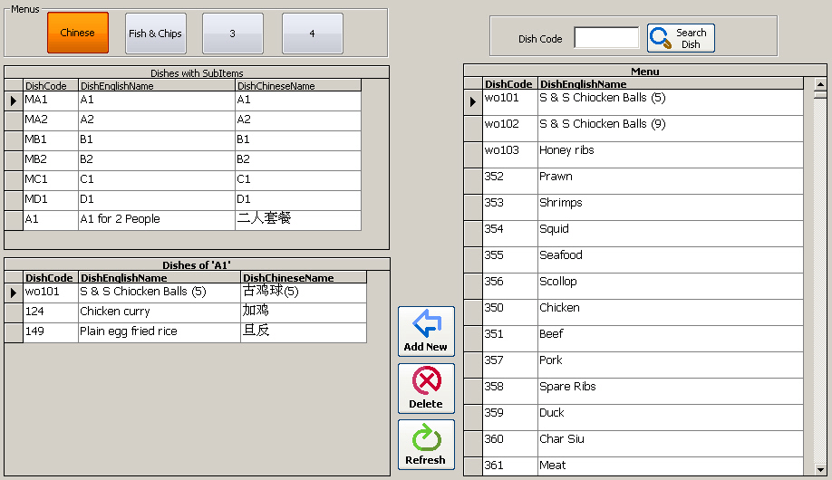
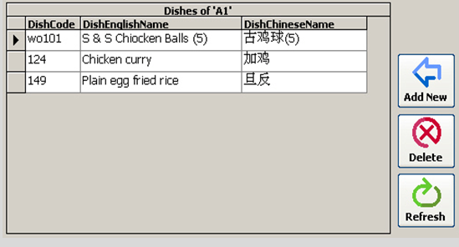

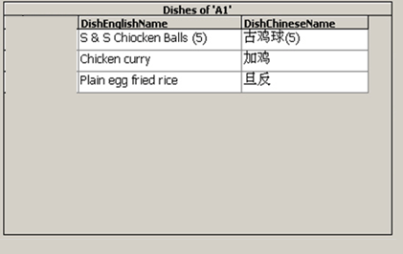

Menu Item
Dish Attributes
Second Choices
Third Choices
Taste Handling
Sub Menu
Defines the dish content of a set meal
Auto Expand
Save
Exit

Slide 14
Manage Menu Set
Menu Set
Chinese
Happy
Meal
3
4
Defines the names of each of the menu set
Copy from one menu to another, can be from TA to Eat In , Quick Dining
Names of Menu Set
English Name
Other Name
Chinese
中國餐
Delete Menu Content
Happy Meal
快樂餐
Delete Menu Content
3
3
Delete Menu Content
4
4
Delete Menu Content
Copy Menu Content
From
Takeaway
Chinese
Copy
To
Eat-In
4
Save
Exit

Slide 15
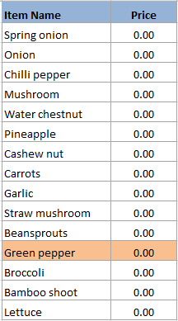
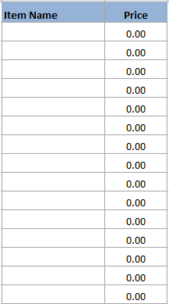
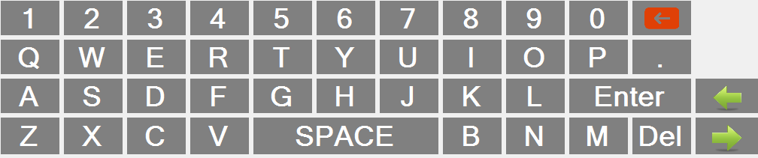
Extra Menu Edit
Button Name
Taste Item
Drink Item
Vegetable
Edit Item
Vegetable
English Name
Green Pepper
Vegetable 2
Other Name
Bean
青椒
Price
Meat
1.50
Seafood
Display Position
2
Sauce
Add
New
Save
Cancel
Taste
Fruit
Cooking
Others
Exit

Slide 16
Order Control
Defines the items for Order Control, this is similar to Taste Handling but this control is used for cooking instructions
Cook when told
Cook now
As starter
As 2nd course
As main course
Hurry please cook
Missing pls cook
Cancel order
Sauce separate
With desserts
Split 2 plates
Split 3 plates
All separate
As takeaway
Cook first
Smaller portion
Edit Item
English Name
Split 3 plates
Save
Cancel
Other Name
分開三碟上
Exit

Slide 17
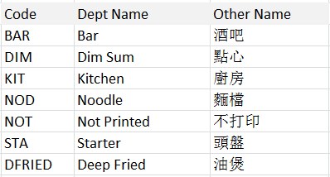
Department Code Entry
Department Code List
Department Code Content Input
Defines Department details and its printer assignment
Dept. Code
KIT
Dept Name
Kitchen
Other Name
廚房
Printer Assignment
Printer Name
Epson TM-88
OK
Number of Copy
2
Print Dishes Separately
Add
New
Copy
Delete
Save
Exit

Slide 18
Quick Dinning Table Setup
1
2
3
4
5
6
7
8
9
10
11
12
13
14
15
16
17
18
19
20
21
22
23
24
25
26
27
28
29
30
31
32
33
34
35
36
37
38
39
40
Table Edit
Button Number
15
Save
Cancel
Ref. Number
88A
Exit

Slide 19
Print Setup
General
Counter Setting 1
Counter Setting 2
Kitchen Setting
Universal Print Options
Print Information
Print Logo
Telephone No.
01206 888 3338
Logo Position
00400
12
VAT No.
82334 123478
Auto Print to Dept.
Message
Thank you please come again
Print Pre Line
3
Message
Easter holiday special meal
Print Post Line
3
Message
Please contact us for details
Message
Please visit our website @
Print Payment Information
Message
www.sunrisebicester.co.uk
Print Payment Type on Bill
Print Subtotal
Print Staff Name
Print Telephone
Print Address
Save
Exit

Slide 20
Print Setup
General
Counter Setting 1
Counter Setting 2
Kitchen Setting
Print Order Number will only show up when pressing CTRL F11
Shop Order Printout Settings
Collection Order Printout Settings
Local Printer
INV
Local Printer
INV
Number of Copy
2
Number of Copy
2
Heading Word
Shop Order
Heading Word
Collection
Heading Font Size
Medium
Heading Font Size
Medium
Print Language
Both
Print Language
Both
English Font Size
Medium
English Font Size
Medium
Other Language Font Size
Medium
Other Language Font Size
Medium
Print Date
Print Date
Print Time
Print Time
Print Order No. Slip
Print Order No. Slip
Print VAT No.
Print VAT No.
Print Customer Name & Phone
Quick Dinning Ref. Number
Print Order No.
Print Order No.
Save
Exit

Slide 21
Print Setup
General
Counter Setting 1
Counter Setting 2
Kitchen Setting
Print Order Number will only show up when pressing CTRL F11
Delivery Order Printout Settings
Customer Receipt Printout Settings
Local Printer
INV
Local Printer
INV
Number of Copy
2
Heading Word
Delivery
Heading Word
Receipt
Heading Font Size
Medium
Heading Font Size
Medium
Print Language
Both
Print Language
English
English Font Size
Medium
English Font Size
Medium
Other Language Font Size
Medium
Other Language Font Size
Medium
Print Date
Print Date
Print Time
Print Time
Print Delivery Sequence No.
Print Order No.
Print VAT No.
Print VAT No.
Driver Printout Copy
2
Print VAT Calculation
Delivery Address Font Size
Large
Save
Exit
Print Order No.

Slide 22
Print Setup
General
Counter Setting 1
Counter Setting 2
Kitchen Setting
Print Order Number will only show up when pressing CTRL F11
Print Language
Both
Print Language Separately
Print Price / Dish Code
Price
Print Ascending Sorting No.
English Font Size
Medium
Print Date
Other Language Font Size
Medium
Print Time
Print Payment Type
Heading Font Size
Medium
Print Delivery Address
Driver Printout Copy
2
Print Delivery Sequence No.
Delivery Address Font Size
Large
Print Price or Dish Code
Price
Print Order No.
Save
Exit
Exit

Slide 23
Driver Set Up
Current Time
Current Date
18:35:36
08/12/2014
Driver Name
Richard
Phone Number
07866878668
New Driver
Working Day
Delete Driver
Sunday
Monday
Tuesday
Wednesday
Save
Thursday
Friday
Saturday
Exit

Slide 24
END
(Slides beyond this page are for references only)

